Slide 1



Supervised Learning
Asteroid Classification
Ferdinand Leube - Edgar Tomé
JUN, 27th | PARIS
DAFT MAY2022

Slide 2


Business case
Domain
Classification of Asteroids if hazardous or not based on different parameters and features
Problem
Apply models of supervised learning, using data of previously observed asteroid, provide predictions for future asteroids/comets based on their observed features

Slide 3
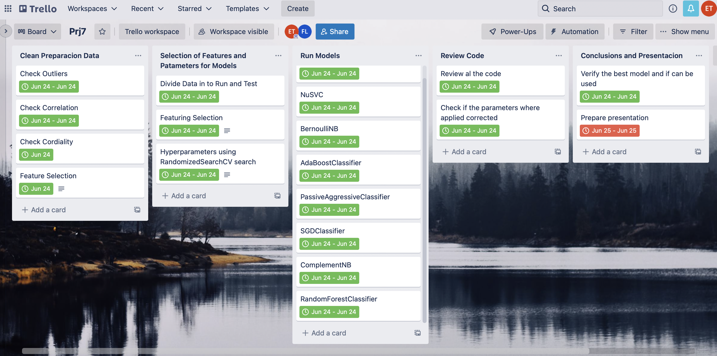
Plan
Review data and case study
Perform EDA and data cleaning
Descriptive analytics
Export clean data for storage
Research of the models to be applied
Featuring Selection
Hyperparameters
Run models
Take conclusions
Presentation

Slide 4
Project Description
practice EDA, data cleaning ,realize every step necessary to apply models of supervised learning and create a model able to classify if an asteroid is hazardous
Project Goal
to develop supervised learning models and compare the results, conclude which model is the best to apply on future data about comets that should be classified as dangerous or not

Slide 5
EDA and Data cleaning
The data cleaning and exploratory data analysis process, was to:
Uniform the date values of different observations for the same asteroid.
Remove one of the features having correlation over 90% →”est_diameter_min”.
Check for outliers and decide how to deal wit them
Remove Id and names of the asteroid, no influence on the models.
Remove orbiting body and sentry object, same value for every object.
Encode hazardous column

Slide 6
Data preparation for models
Divide the data in features and results, X and Y, preparing different data sets according to feature selection, getting five data sets.
Preparing the data to be applied on the models, dividing in Train and Test samples, Test consisting of 20% of the original data
by random selection, without future selection.
Used different functions for feature selection, applied in the same model, Random Forest Classifier.
SFM - selecting features based on importance weights.
RFE – ranking with recursive feature elimination.
RFECV – recursive feature elimination wit cross-validation to select the number of features.
SFS – sequential feature selection.

Slide 7
Hyperparameters – Random Search
Applied random search to define the best parameters, acording to the paramters importance and influence on ist model
Logistic regression – there is no necessity to tune the parameters.
Nu-Support Vector Classification (NuSVC) – nu (upper bound of the fraction of margin errors and lower bound of the fraction of support vectors)
Bernoulli NB – fit_prior (learn class prior probabilities, True or false).
Ada Boost Classifier – number of estimators (which boosting is terminated).
Passive Aggressive Classifier – fit_intercept (the intercept should be estimated or not), max_iter (number of passes over the training data).
SGDC Classifier - fit_intercept (the intercept should be estimated or not), max_iter (number of passes over the training data).
Complement NB – norm (to perform or not second normalization of the weights) , fit_priot (used in edge case with a single class in training set).
Random Forest Classifier – Max features, Min samples leaf, number of estimators.

Slide 8
Models Applied – Supervised learning
Logistic regression – statistical method for predicting binary classes.
Nu-Support Vector Classification (NuSVC) – classifies by vectors.
Bernoulli NB – is a variant of naive Bayes, classification of the likelihood of occurrence, that accepts binary values of true and false.
AdaBoost Classifier – decision trees with one level
Passive Aggressive Classifier – classification algorithm by online learning.
SGDC Classifier – implements regularized linear models with stochastic gradient descent.
Complement NB – is a variant of naive Bayes, particularly suited for imbalanced data sets.
Random Forest Classifier – estimator that fits a number of decision tree classifiers.

Slide 9
Passive Aggressive Classifier - Detailed
Passive Aggressive Classifier belongs to the category of online learning algorithms in machine learning.
Passive-Aggressive algorithms are generally used for large-scale learning. It is one of the few ‘online-learning algorithms‘. In online machine learning algorithms, the input data comes in sequential order and the machine learning model is updated step-by-step, as opposed to batch learning, where the entire training dataset is used at once.
This is very useful in situations where there is a huge amount of data and it is computationally infeasible to train the entire dataset because of the sheer size of the data. We can simply say that an online-learning algorithm will get a training example, update the classifier, and then throw away the example.
How Passive-Aggressive Algorithms Work: Passive-Aggressive algorithms are called so because :
Passive: If the prediction is correct, keep the model and do not make any changes. i.e., the data in the example is not enough to cause any changes in the model.
Aggressive: If the prediction is incorrect, make changes to the model. i.e., some change to the model may correct it.
Important parameters:
C : This is the regularization parameter, and denotes the penalization the model will make on an incorrect prediction
max_iter : The maximum number of iterations the model makes over the training data.
tol : The stopping criterion. If it is set to None, the model will stop when (loss > previous_loss – tol). By default, it is set to 1e-3.
Notes:
Used on fake news na twiter

Slide 10
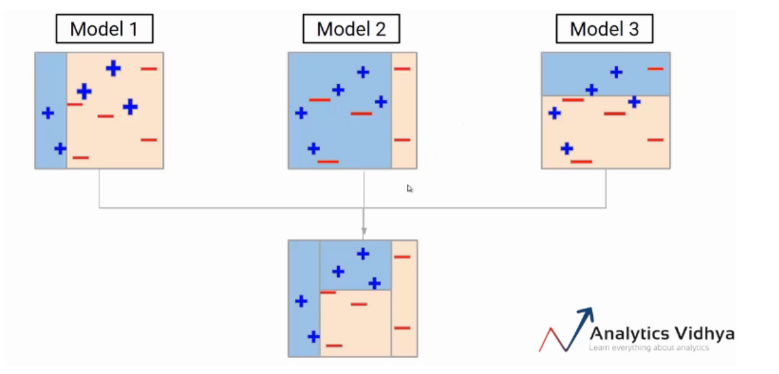
ADA Boost Classifier - Detailed
AdaBoost algorithm starts by building a model using decision trees to classify the data, with every value being equally weighted
Stops until he receives a split output consisting only of one value
Checks the other groups for miscalculated/misclassified values and now builds a second model where these values are being weighted more
→ Meaning: the aim of the algorithm is not to stop until he finds a model classifying these miscalculated values correctly
BUT !
Because of this focus →others have been misclassified and process of finding model correctly classifying these new heavily weighted values starts over again
Result → multiple different models
Result → a model that has all the different classifications from the previous n models
Notes:
After end result: not perfect, but finding different forms of classifications able to identify a group of equal values correctly due to certain characteristics these different models are then combined
it has multiple ways know of classifying a value based on multiple conditions known to be true from the previous models
multiple weak learners are combined to one strong learner

Slide 11
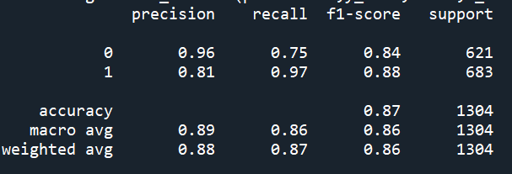
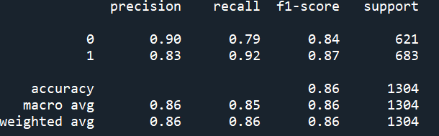
Observations
None of the models had significant results
Accuracy → decent
Problem: low recall and precision score for actually correctly classifying all the dangerous comets
New attempt:
Modified our data to have same amount of dangerous and not dangerous comets
Randomly selected same amount of both
Because this was only a test we did not rerun all hyperparamter selections
BUT !!
Even with default parameters two of our models had very high results for all important scores
ADA Boost Classifier
Random Forest Classifier

Slide 12
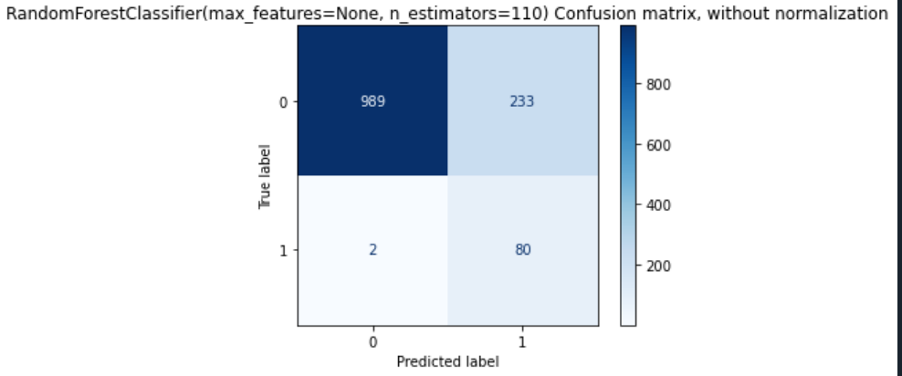
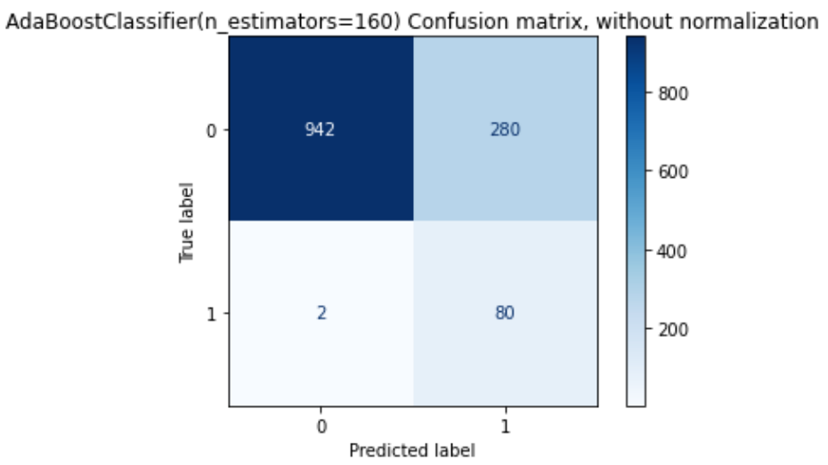
Observations
Checked the models with new randomly created samples and:
Once again!
satisfying results in regard of our business case:
Identifying with highest possible certainty every dangerous comet

Slide 13
Supervised Learning
Questions?
Ferdinand Leube - Edgar Tomé
Merci

